Slide 1

Patents and IP
Why you should care
Rebecca Olson, Business and Social Science Informationist, UC Libraries ASKDATA@uc.edu
Notes:
Introduction – Background – current job.
Ask what typed of IP they are familiar with.

Slide 2
Intellectual Property
NEW!!!!
Patents – legal method to protect a novel way of doing something.
Trademarks –word, phrase, symbol, sound, color, scent or design. Logo, brand, catch phrase.
Copyrights – “published” material
Trade Secrets – recipes, software code, customer lists, algorithms, other tech info.
Notes:
Discuss when to use which....
Trade Secrets are often used by start ups with Apps – since Apps are quick, fast, may not have time to be protected by other IP. Non Disclosure agreements. Might be able to find them by running a news search in Nexis Uni for the company name and "trade secret"

Slide 3

Pop QUIZ
"Peer to peer information exchange for mobile communications devices"
Notes:
What IP do we see here on the left? Ans – Diet Coke – Trademark and trade secret (Recipe)
Right – is the patent title for Bluetooth.

Slide 4
IP and you
Median cost of patent litigation for value of $1to10 million is $2 million!!! (AIPLA Survey, 2017)
Inventors – protect your idea!
Investors – protect your money!
Individuals – Do your Due Diligence!
Notes:
Who is here as an inventor? Who is here as an investor?
Think about IP - litigation could be much, much more than the cost of a patent.

Slide 5
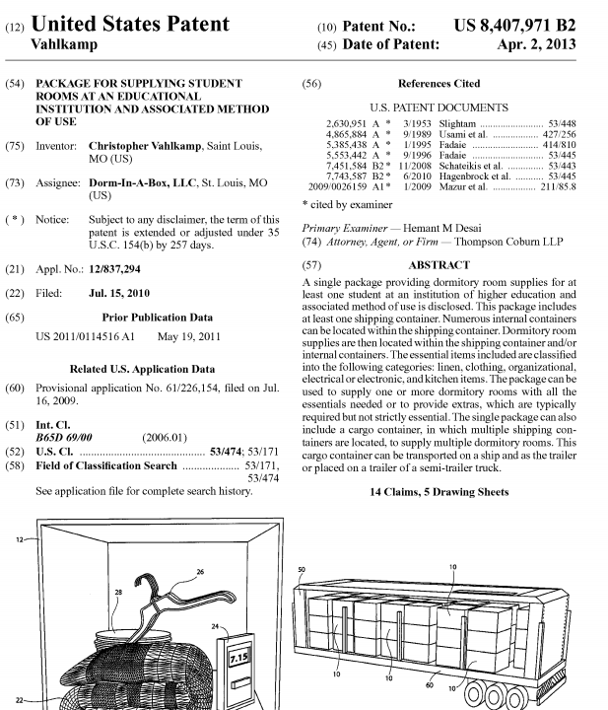
the patent
Title
Inventor(who created it) and Assignee (who owns it)
Filing Date
Abstract
Related publications and classification codes
14 claims
Notes:
This is a patent for a service that lets you order your whole dorm room in a box.
Discuss the parts of the patents – Why it's important to understand the parts before you start searching.
Only important part – claims. But other info should be searched.

Slide 6
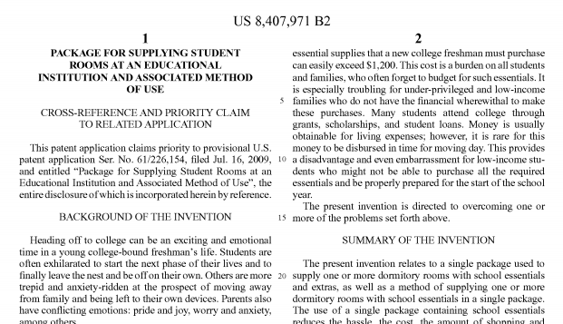
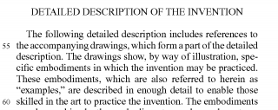
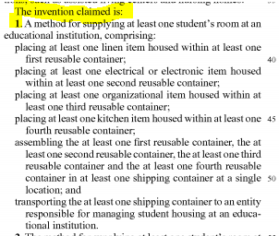
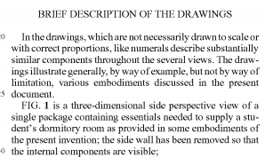
Parts of the patent
Contains Claims, eventually.
Any other related patents?
CLAIMS
Why and what is this invention for?
Drawing info
Notes:
Continue discussing parts of the patent

Slide 7
Searching Patents – WHERE?
USPTO.gov
Lens.org
Google Patent
Derwent Innovation Index (UC Libraries)
TotalPatentOne via Nexis-Uni (UC Libraries)
Notes:
Where should you start?

Slide 8
Searching Patents – WHAT? HOW?
I want to search: | How should I search?
For the inventor! | AU = Author = Inventor
Just to browse | Full text search
Targeted search for my tech | Title, Claims, Abstracts (TI, CL, AB)
I found a patent, and want to find similar ones. | Search by similar class code.
For all patents this company owns. | AN = Assignee
Granted US Patents usually end in B.
Notes:
Open Lens.org and walk through a search.

Slide 9
SEARCHING TRADEMARKS
USPTO.gov [TESS]
General Google Search
Domain registration sites
TESS Searching:
Search by Owner
Search by Actual Term
Search by Goods & Services code
Look for LIVE/DEAD status

Slide 10
Don’t take my word for it…
Inventor/Entrepreneur assistance in Ohio from the USPTO
NKU’s Intellectual Property Awareness Center (offers classes at Cinci Pub Lib)
1819’s Venture Lab and Tech Transfer Teams
Patents Research Guide from UC Libraries

Slide 11
Wait, there’s more!
Search strategy:
“Seven Step Strategy.” USPTO
https://www.uspto.gov/learning-and-resources/support-centers/patent-and-trademark-resource-centers-ptrc/resources/seven
Gordon, T., Cookfair, A., LoTempio, V., Lillis, B. (2013). Patent Fundamentals for Scientists and Engineers. Boca Raton: CRC Press, https://doi.org/10.1201/b12982
http://uclid.uc.edu/record=b6872262~S39
Hitchcock, D. (2017). Patent Searching Made Easy : How to Do Patent Searches Online and in The Library (Vol. 7th edition). Berkeley, CA: NOLO.
http://uclid.uc.edu/record=b6320232~S39
Lupu, M. (2011). Current challenges in patent information retrieval. Berlin: Springer. doi: https://doi.org/10.1007/978-3-642-19231-9
http://uclid.uc.edu/record=b5538668~S39
Nissing, N. (2013). Patents and strategic inventing: the corporate inventors guide to creating sustainable competitive advantage. McGraw Hill.
http://uclid.uc.edu/record=b6813465~S39

Slide 12
Currano, J., & Roth, D. (Eds.). (2013). Chemical information for chemists : A primer.
http://uclid.uc.edu/record=b6051654~S39
Law Library resource:
Stobbs, G.A. (2012, updates, 2019). Software Patents. New York, NY: Wolters Kluwer Law & Business
Law Stacks KF3133.C65 S76 2012
http://uclid.uc.edu/record=b5628038~S39
QUINN, G. (2016). Why Patent Searches Are Always a Good Idea. Inventors’ Digest, 32(4), 22. Retrieved from http://search.ebscohost.com/login.aspx?direct=true&db=bth&AN=114162734&site=ehost-live&scope=site
Hitchcock, D. (2017). Patent Searching Made Easy : How to Do Patent Searches Online and in The Library (Vol. 7th edition). Berkeley, CA: NOLO. Retrieved from http://search.ebscohost.com/login.aspx?direct=true&db=nlebk&AN=1473267&site=ehost-live&scope=site
Clark, N.S. (2018). The Basics of Patent Searching. World Patent Information, 54(Supp), S4-S10. Retrieved from https://doi.org/10.1016/j.wpi.2017.02.006. http://www.sciencedirect.com/science/article/pii/S017221901630103X
Even with an open source based start-up, Trademarks are still important.
Loney, M. (2018). Inside the IP needs of a $1 billion start up. Managing Intellectual Property, N.PAG. Retrieved from http://search.ebscohost.com/login.aspx?direct=true&db=bth&AN=131689460&site=ehost-live&scope=site
Michels, R. (2014, September 5). Trademark Searching Like A Rock Star. Mondaq Business Briefing. Retrieved from https://bi.gale.com/global/article/GALE%7CA381591631/72865696b6f279166c0ecb79df2da9d4?u=ucinc_main

Slide 13
Loney, M. (2018). Global trade mark survey finds increase in infringement and filing.Managing Intellectual Property, Retrieved from https://search.proquest.com/docview/2010268055?accountid=2909
Hinton, J. (2015, May 8). The New Innovator’s Commercialization Dilemma. Mondaq Business Briefing. Retrieved from https://bi.gale.com/global/article/GALE%7CA412733167/24b5aa4576944d8fe08b28fb16e8fcbc?u=ucinc_main
Levine, D. S., & Sichelman, T. (2018, December). WHY DO STARTUPS USE TRADE SECRETS? Notre Dame Law Review, 94(2), 751+. Retrieved from https://link.gale.com/apps/doc/A572943403/EAIM?u=ucinc_main&sid=EAIM&xid=d2dd06a9
Vermont, S. (2017) Median Costs of Patent Litigation. AIPLA Survey of Costs of Patent Litigation and Inter Partes Review. Retrieved from:
https://www.patentattorney.com/aipla-survey-of-costs-of-patent-litigation-and-inter-partes-review/

